Slide 1


Predictive Bill Tracker empowers legislators and organizations to strategically navigate the legislative landscape by predicting which bills are likely to pass Congress.
AI-Powered Bill Tracker: Predicting Legislative Success

Slide 2
Complexity of Bills
01
The sheer volume of legislation (8,000+ bills per year) makes it difficult for stakeholders to track significant bills effectively.
Inefficiency in Tracking
02
Current systems lack the capability to filter through numerous bills, leading to missed opportunities for advocacy.
Need for Automation
03
Implementing an AI-driven approach can streamline the process, enhancing accuracy in predicting which bills will pass.
The Challenge of Legislation
Navigating the overwhelming landscape of 16,000 bills to identify the 274 that truly matter

Slide 3



Phase 1: Viability Detection - Will this bill gain traction?
Two-Phase AI Prediction System
20% of bills are viable
Smart filtering for accurate legislative insights
Phase 2: Passage Prediction - Will viable bills become law?
How it works:
- Phase 1: AI identifies viable bills (20% pass this filter)
- Phase 2: Predicts passage likelihood for viable bills only
Time-aware models:
- New bills (Day 1) - Limited data analysis
- Early stage (2-30 days) - Momentum tracking
- Progressive (30+ days) - Full pattern analysis
Result: Enhances accuracy and visibility of the model, ensuring stakeholders are well-informed and proactive
Only bills that are predicted to be viable will be evaluated in this phase.

Slide 4
Technical Architecture Overview
The AI uses ensemble machine learning, with 38 features including legislative momentum, bipartisan support ratios, and committee engagement.
Ensemble Model: Combines all 3 models
Random Forest (40% weight) - Detects non-linear patterns
Gradient Boosting (40% weight) - Finds complex feature interactions
Logistic Regression (20% weight) - Adds stability to the model

Slide 5
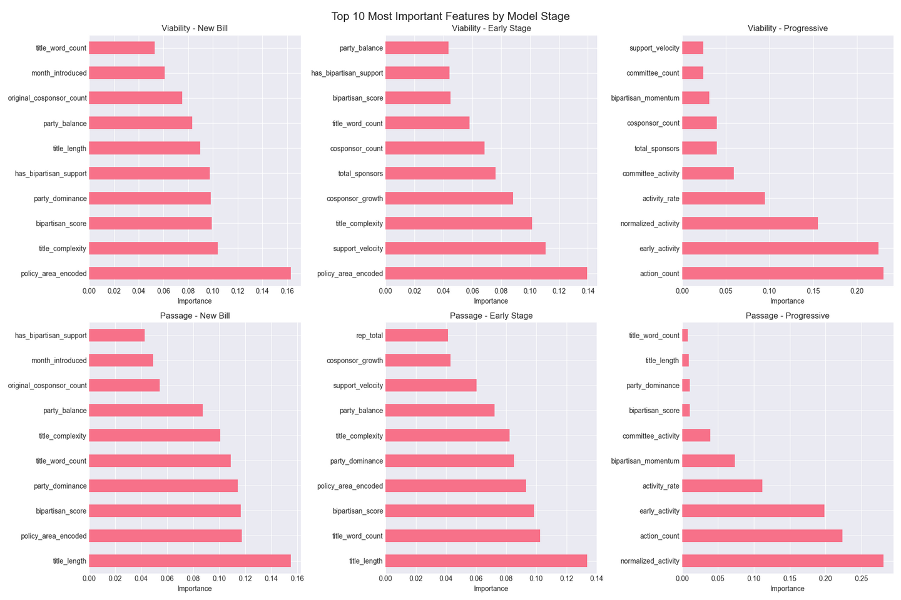
Key Insights in Bill Passage
What makes bills succeed?
- Number of actions in bills (roll calls, votes, committee referrals) is crucial to bill success
- First 30 days are critical, as shown in the early_activity parameter
- Policy area is important for early-stage viability, but not as much for later stages

Slide 6
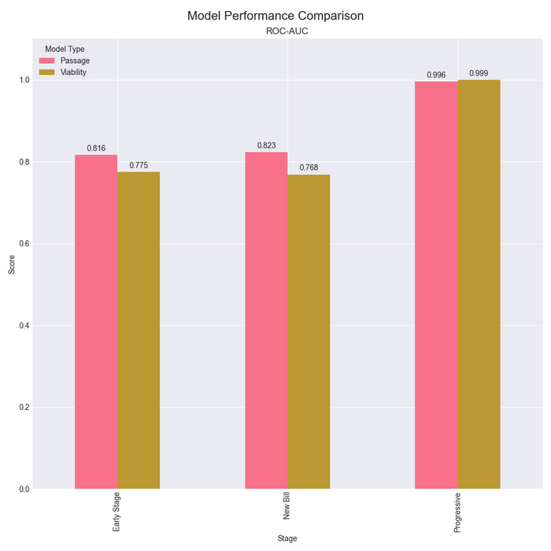
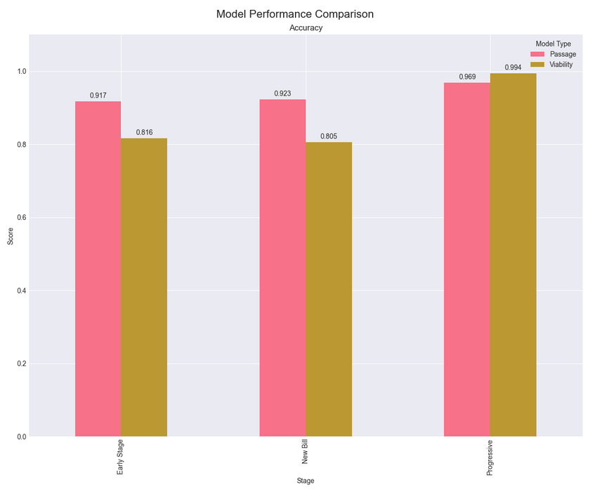


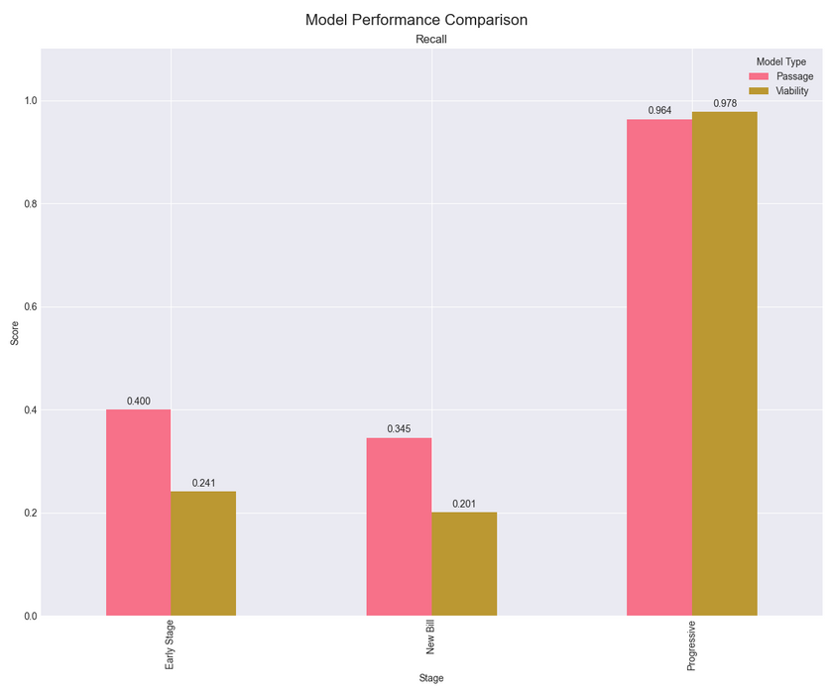
Model Performance
This gallery showcases the performance metrics dashboard, highlighting key indicators of success including a high accuracy and ROC-AUC score. The performance on recall may seem low, but with less than 2% of proposed bills passing, it is already very hard to predict passage with the limited information provided to the early-stage and new bill models.

Slide 7

Impact Analysis on Stakeholders
Democratizing Legislative Intelligence: Understanding the implications for citizens, advocacy groups, and legislators in policy-making
This predictive bill tracker, powered by AI-driven legislative tracking has significant effects on various stakeholders. Citizens gain transparency and access, advocacy groups can leverage data for their causes with efficient resource allocation, and legislators receive valuable insights to inform their decisions and improve bill design.

Slide 8
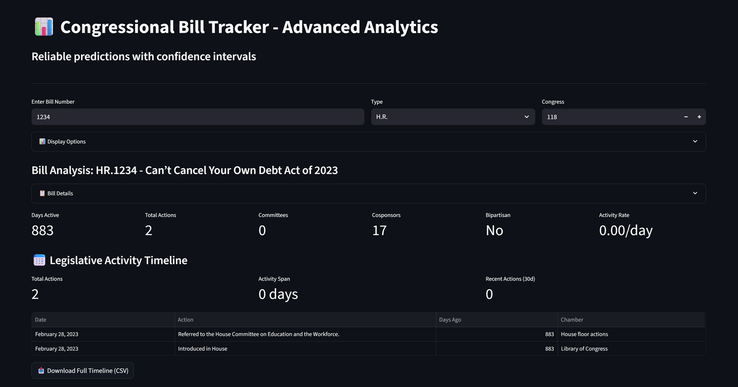
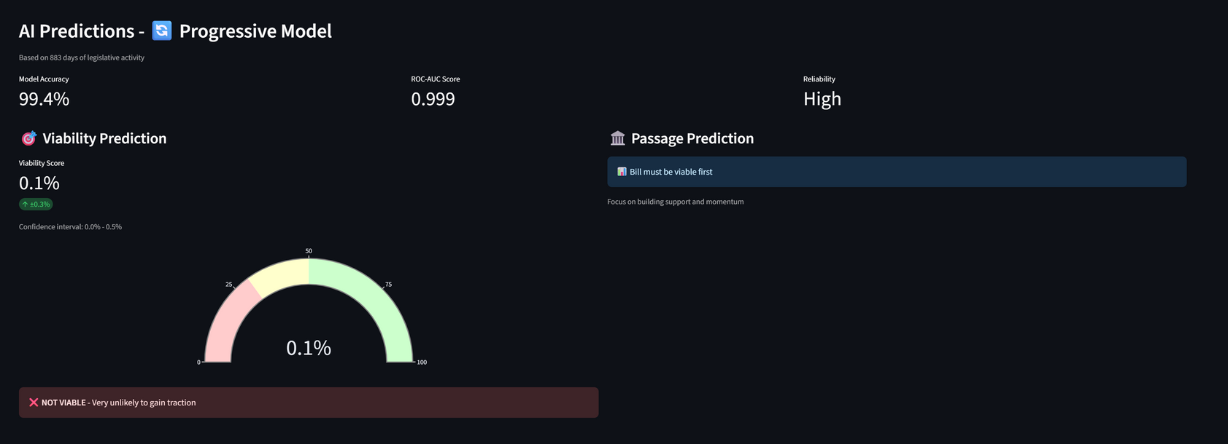
Demo Highlights
Key Features In Action:
- Real-time Congress.gov API integration
- Confidence intervals show model uncertainty
- Time-aware predictions (Progressive Model shown)
- Interactive gauge visualizations
- Complete legislative timeline tracking
- Live viability and passage predictions

Slide 9


Future Vision
A Roadmap Ahead: Building a more transparent democracy
Possible Next Steps:
- State legislature integration
- Real-time amendment tracking
- Public sentiment analysis
- Predictive alerts
- Mobile application
- API for researchers

Slide 10
Thank you!
GITHUB
LINKEDIN
github.com/oliversoctopus
linkedin.com/in/oliversfan
EMAIL ADDRESS
oliver.s.fan@gmail.com
© 2025 OLIVER FAN

